Slide 1

LECTURE 13: TOEIC WRITING
Introduction to Question 8 An Opinion Essay

Slide 2
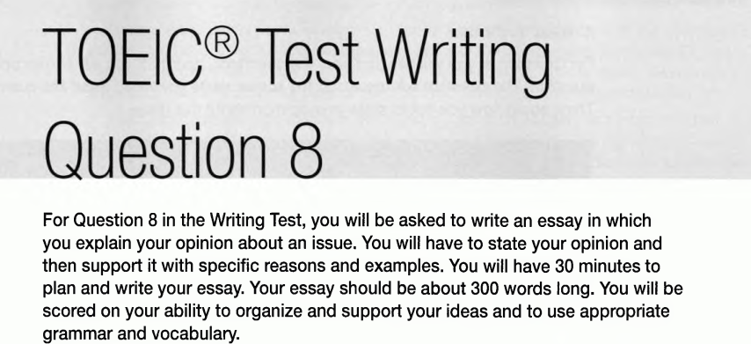

Slide 3
Some common topics
Work issues
Shopping practice
Leisure time activities
Friendship and family
Travel and transportation choices

Slide 4
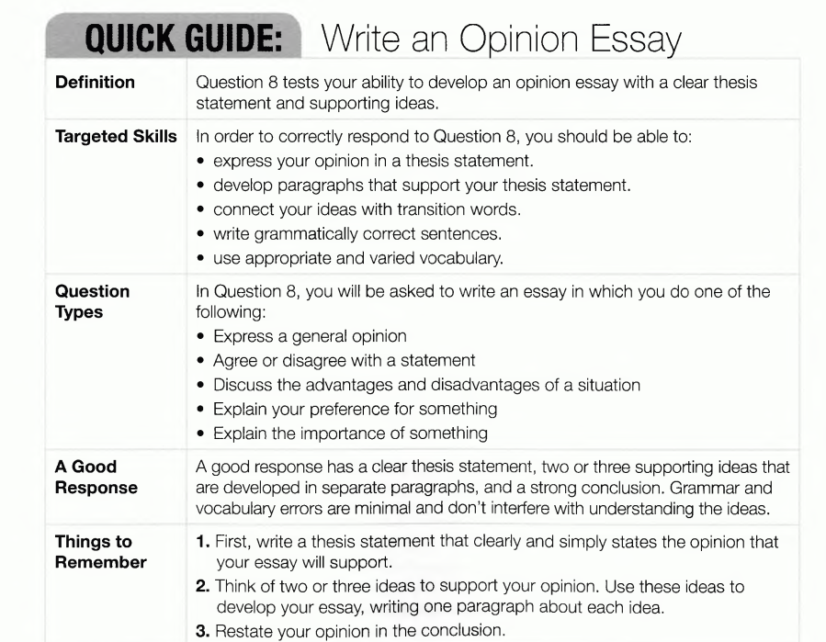

Slide 5
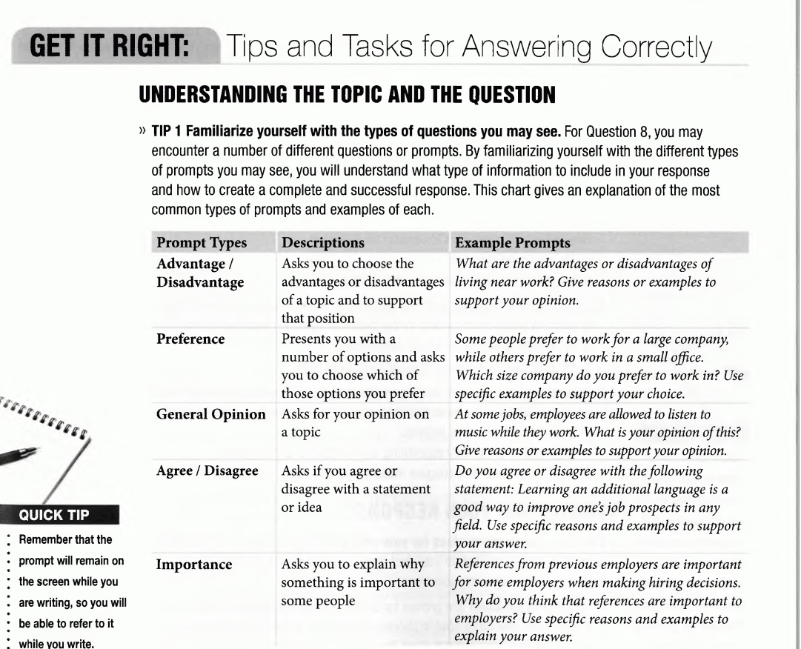
Work in groups: underline the key words for each type

Slide 6
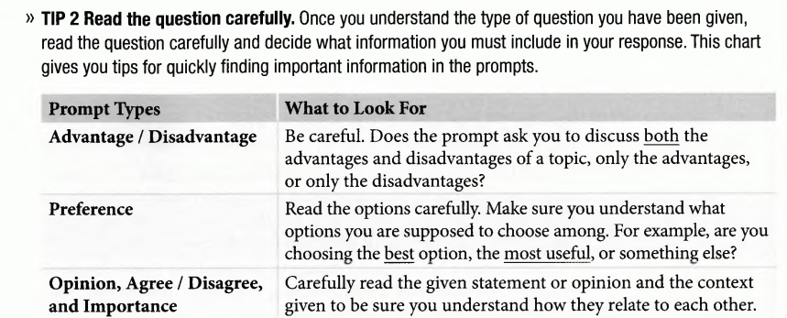

Slide 7
Structuring Your Response
Tip 1: Brainstorm ideas for your essay
Brainstorm ideas
What is my position?
What is my thesis
What I want to say?

Slide 8
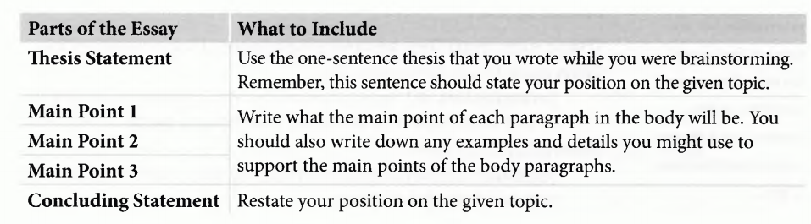
Structuring Your Response
Tip 2: Create a basic outline of what you want to write

Slide 9
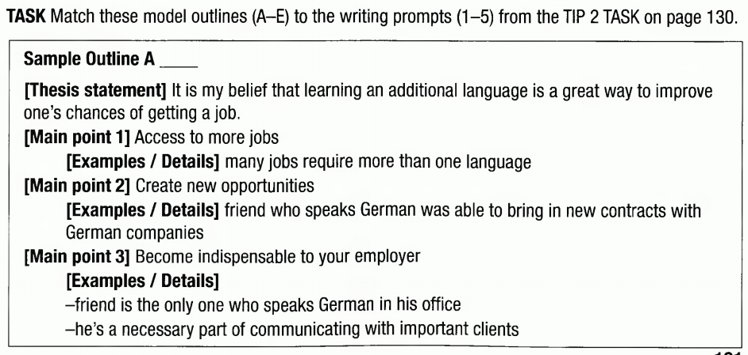
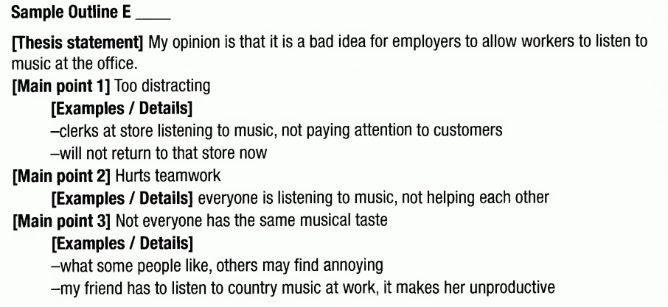
Structuring Your Response
Tip 2: Create a basic outline of what you want to write

Slide 10
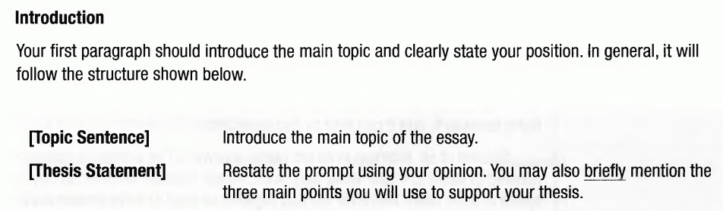
Structuring Your Response
Tip 3: Write a rough draft of your essay

Slide 11
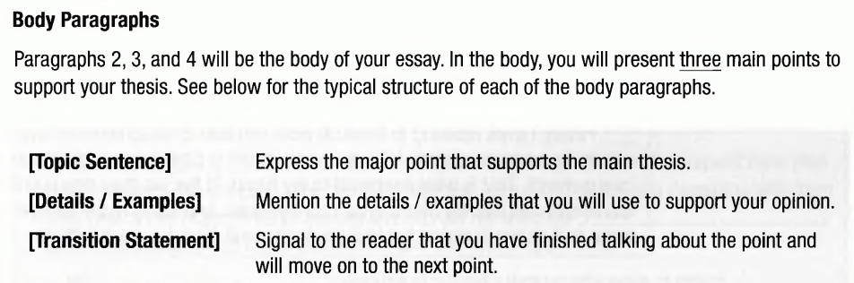
Structuring Your Response
Tip 3: Write a rough draft of your essay

Slide 12
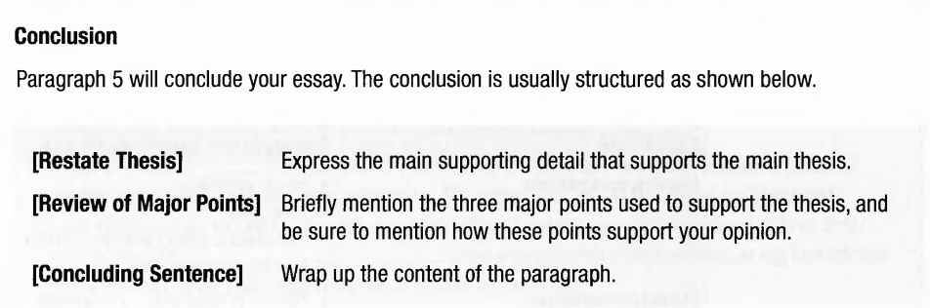
Structuring Your Response
Tip 3: Write a rough draft of your essay

Slide 13
Structuring Your Response
Tip 4: Learn useful language to use in writing your essay

Slide 14
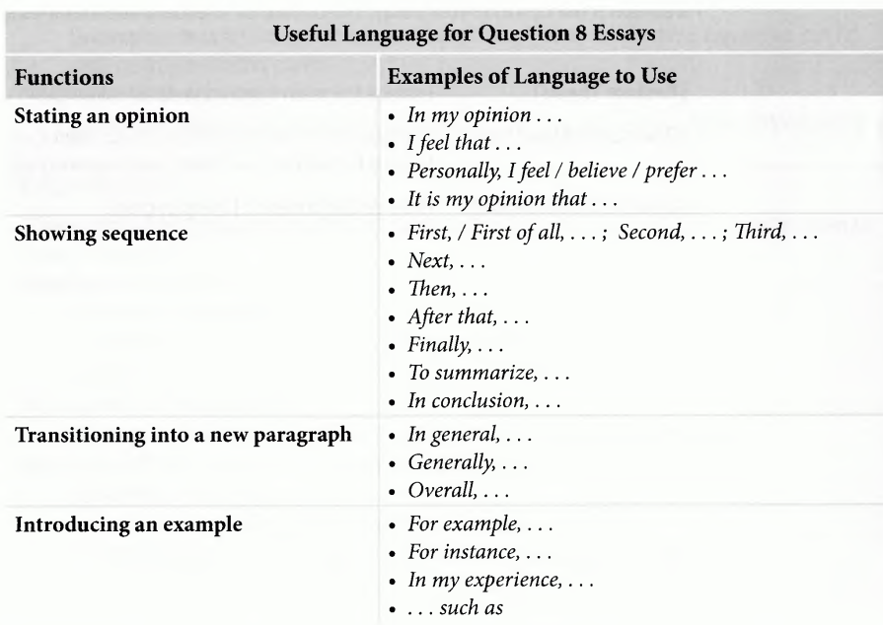

Slide 15
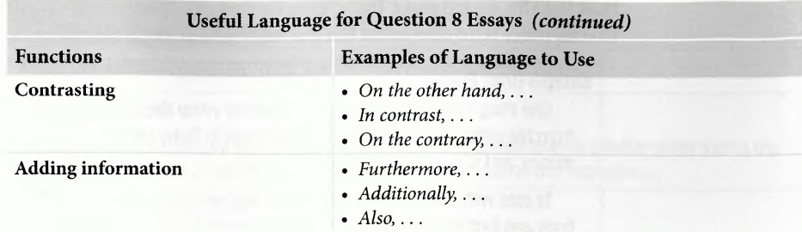

Slide 16
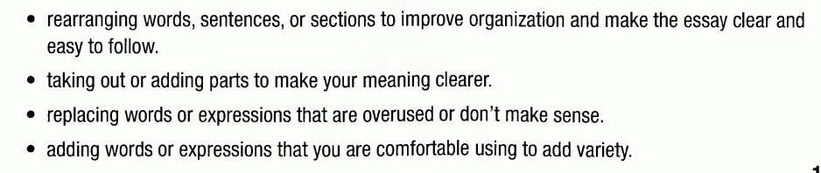
Structuring Your Response
Tip 5: Revise your essay

Slide 17
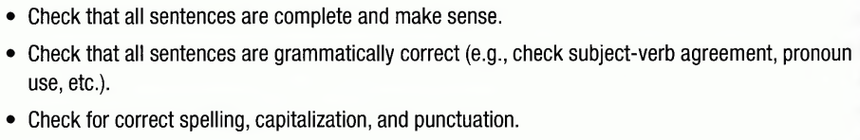
Structuring Your Response
Tip 6: Correct your essay

Slide 18
TIP 1:
Brainstorm ideas for your essay
Create a basic outline of what you want to write
Write a rough draft of your essay
TIP 2:
TIP 3:
TIP 4:
Learn useful language to use in writing your essay
TIP 5:
Revise your essay
TIP 6:
Correct your essay

Slide 19
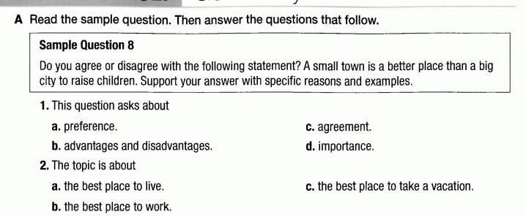
PROGRESS PRACTICE

Slide 20

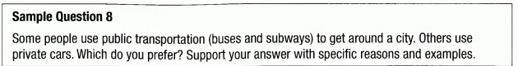
Homework
Choose one of the discussed topics and complete your essay.

